Slide 1

Constructive Alignment

Slide 2
Learning Outcomes:
At the end of this session, you will be able to:
Draw up an assessment plan
Evaluate an examination paper & memo according to the relevant NQF level of the module.

Slide 3
Key areas of educational development
Course design: including ensuring that courses and modules are constructed on a sound educational basis, in relation to the student profile and the desired learning outcomes.
Teaching approaches: including the use of educational technology, and with particular reference to dealing effectively with the realities of diversity and large classes.
Assessment: particularly the alignment of assessment with curriculum/course design and learning outcomes.
Notes:
Strategies for educational development are many and varied, and it is not feasible to discuss them in any detail here. However, a brief outline of key areas of educational development that are relevant in South Africa provides an overview of the scope of the work at institutional level. The following three are quoted (Scott, Yeld & Hendry 2007:57-58):
• Course design: including ensuring that courses and modules are constructed on a sound educational basis, in relation to the student profile and the desired learning outcomes.
• Teaching approaches: including the use of educational technology, and with particular reference to dealing effectively with the realities of diversity and large classes.
• Assessment: particularly the alignment of assessment with curriculum/course design and learning outcomes.

Slide 4
What determines the way in which we assess?
Purpose of qualification (broad)
e.g. undergrad vs. postgrad
Purpose of module/subject (narrower) e.g. mathematics vs. English
Learning outcomes (specific)
e.g. list the 10 steps of … vs. design a computer programme which…
Notes:
According to Biggs (2003:1-2) constructive alignment has two aspects. The constructive aspect refers to the idea that students construct meaning through relevant learning activities. That is, meaning is not something imparted or transmitted from teacher to learner, but is something learners have to create for themselves. The alignment aspect refers to what the teacher does, which is to set up a learning environment that supports the learning activities appropriate to achieving the intended outcomes. The key issue is that the components in the teaching system, especially the teaching methods used and the assessment tasks are aligned to the activities assumed in the intended outcomes. The learner is in a sense trapped; it is difficult to escape without learning what is intended should be learned.
As indicated in the figure in this slide, in setting up an aligned system, we specify the desired outcomes of our teaching in terms of not only the topic of the content, but also in the level of understanding that students need to achieve. We then set up an environment that maximises the likelihood that students will engage in the activities designed to achieve the outcomes. Finally we choose assessment tasks that will tell us how well individual students have attained these outcomes.

Slide 5
CONSTRUCTIVE ALIGNMENT
1. Defining the desired learning outcomes.
2. Choosing teaching and learning activities likely to lead to the outcomes.
3. Assessing students’ actual learning to see how well they match the outcomes.
4. Arriving at a final grade/result.
CONSTRUCTIVE ALIGNMENT
Notes:
There are thus four major steps:
• Defining the desired learning outcomes.
• Choosing teaching and learning activities likely to lead to the outcomes.
• Assessing students’ actual learning to see how well they match the outcomes.
• Arriving at a final grade/result.
It is important to note that the learner achieves outcomes which build up to the purpose of the unit standard, and achieves unit standards which build towards the purpose of the qualification. This is why it is important to design down from the purpose of the qualification or the unit standard, so that it is always on the foreground when we plan learning and assessment for the outcomes. Once the design down process is complete you will ‘deliver up’, that is, conduct learning activities which will prepare your learners for the assessment activities. These in turn will provide evidence that they have met the outcomes and thereby have achieved the purpose of the qualification

Slide 6
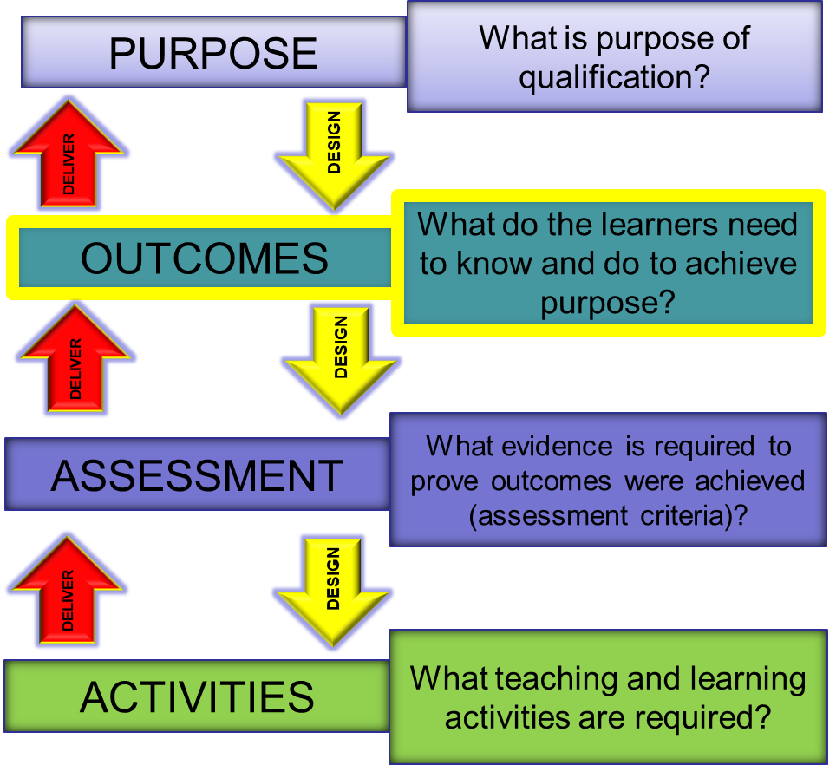
Notes:
It is important to note that the learner achieves outcomes which build up to the purpose of the unit standard, and achieves unit standards which build towards the purpose of the qualification. This is why it is important to design down from the purpose of the qualification or the unit standard, so that it is always on the foreground when we plan learning and assessment for the outcomes. Once the design down process is complete you will ‘deliver up’, that is, conduct learning activities which will prepare your learners for the assessment activities. These in turn will provide evidence that they have met the outcomes and thereby have achieved the purpose of the qualification (SAQA 2005a:5-6).
Desing down, deliver up.

