Slide 1

PowerPoint Magic

Slide 2
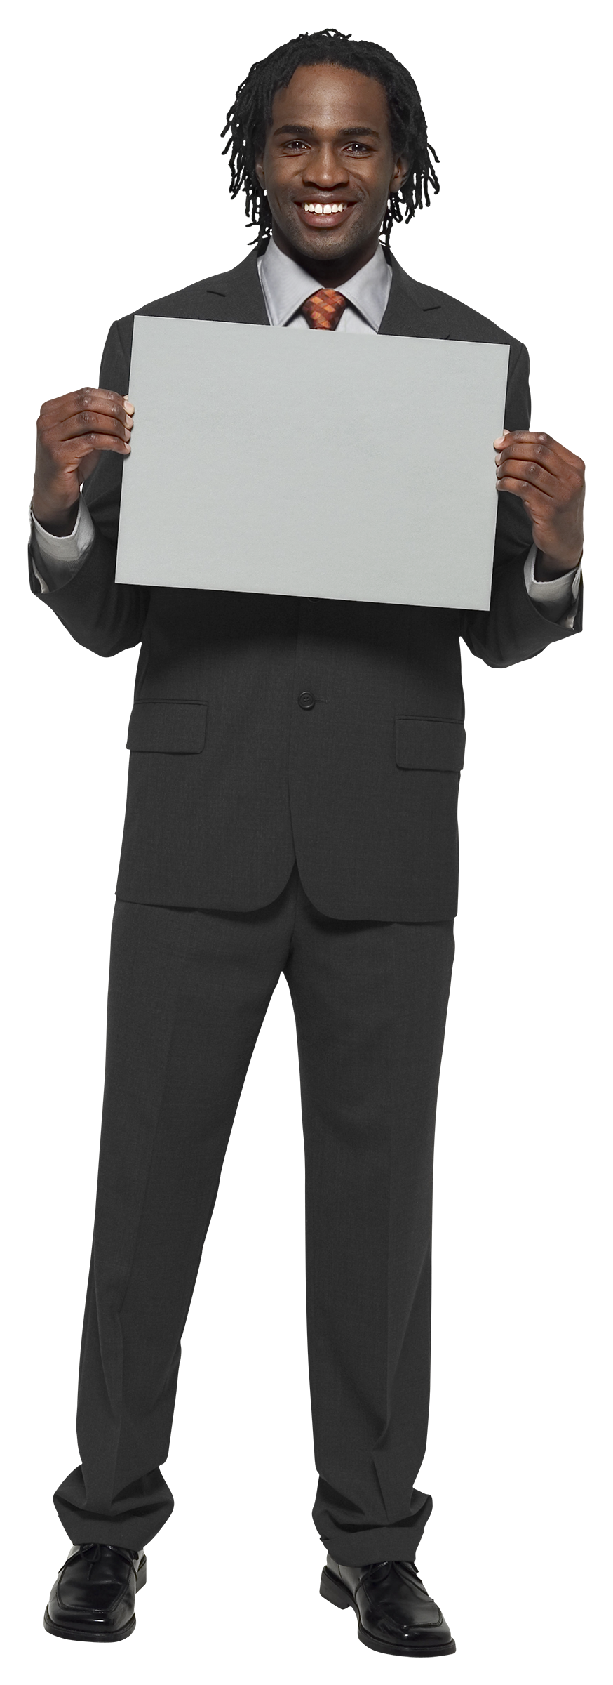
Graphic with Layers
My hair looks way better than Trumps’ right...?

Slide 3
Pictograms

Slide 4
Pictograms
Time to try your hand at it… ☺

Slide 5



Resize Recolour Filter

Slide 6
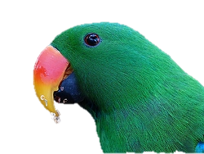
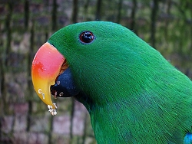
Remove background
Change the shape and colour of the background

Slide 7
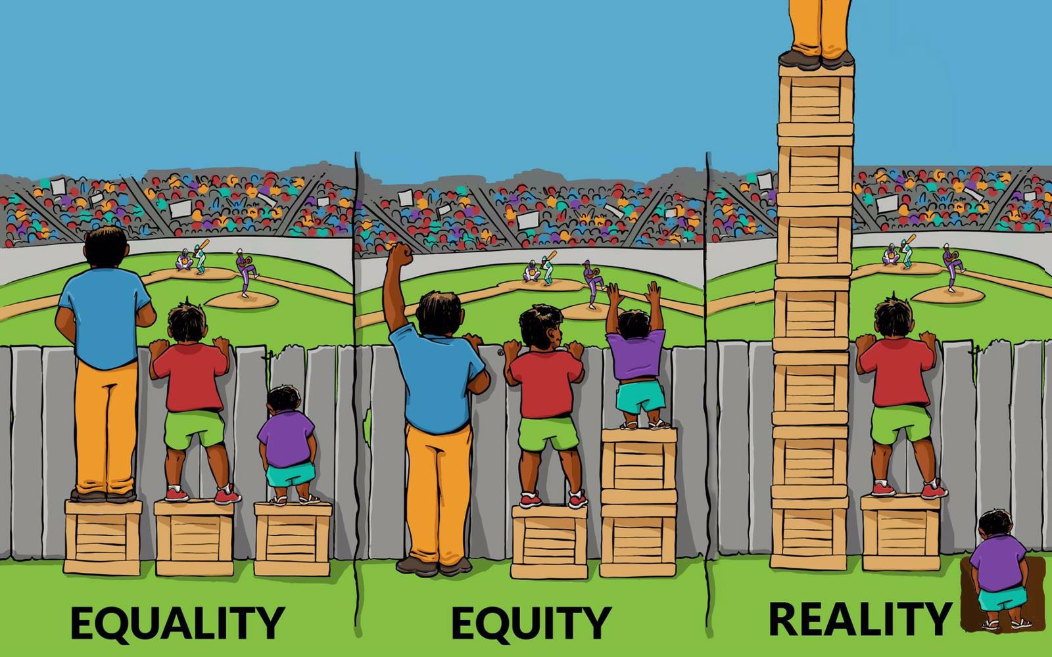
Crop

Slide 8

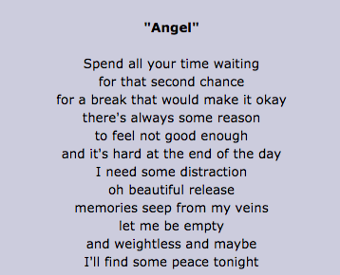


Audio

Slide 9

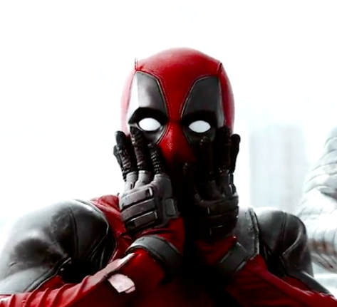
Video clip that starts playing when you click

