Slide 1

Learning Outcomes and Assessment Criteria

Slide 2
Learning Outcomes:
At the end of this session, you will be able to:
Write Learning Outcomes and Assessment Criteria
Use taxonomies for assessment to design assessment activities
Evaluate an assessment activity

Slide 3

Exit Level Outcomes & Associated Assessment Criteria
The Exit Level Outcomes, which are framed against the Level Descriptors, should indicate what the learner will be able to do and know as a result of completing the qualification or part qualification.
Associated Assessment Criteria are written for the qualification to indicate the nature and level of the assessment associated with the qualification and how the Exit Level Outcomes could be assessed in an integrated way. The criteria can be given as a comprehensive set derived from the Level Descriptors.

Slide 4

SAQA Level Descriptors
Ten categories are used in the level descriptors to describe applied competencies across each of the ten levels of the National Qualifications Framework, which are:
Scope of knowledge:
Knowledge literacy
Method and Procedure:
Problem solving:
Ethics and professional practice:
Accessing, processing and managing information:
Producing and communicating information
Context and systems:
Management of learning:
Accountability

Slide 5
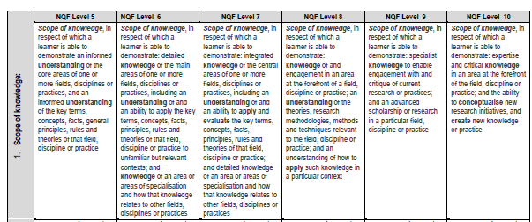

SAQA Level Descriptors

Slide 6
Learning Outcomes
statements of what a students are expected to…
know,
understand and
be able to do/demonstrate…
on successful completion of a learning experience.
e.g.
At the end of this learning experience the student should be able to:
write learning outcomes using the prescribed FPD format

Slide 7
“At the end of this learning experience the student should be able to “
verb + noun + condition
(content/practice) (context & extent)

Slide 8
Assessment Criteria
Are?
LOs translated into practice
Characteristics:
Specify the detailed tasks on which the student
will be assessed
Are aligned to the LOs, teaching and learning
activities and assessment tasks

Slide 9
AC express:
  the content/practice (elements of the noun being assessed) WHAT?
  the verb (what the graduate will have to do with the content) HOW?
  the context (where it will be used) WHERE/WHEN?
  the extent (to what end/ for what means) WHY?

Slide 10
The list of Assessment Criteria is preceded with the following introductory phrase:
“This will be evident when…“
noun + verb + condition
(content/practice) (context & extent)

Slide 11
Example
LO: Students should be able to …perform chemistry laboratory experiments
AC: This will be evident when…
instructions are followed according to the prescribed format;
principles of safe laboratory experimentation are applied;
necessary equipment is prepared;
and experiments are conducted according to the protocol in the laboratory

Slide 12
Example
LO: Students should be able to …perform chemistry laboratory experiments
AC: This will be evident when…
instructions are followed according to the prescribed format;
principles of safe laboratory experimentation are applied;
necessary equipment is prepared;
and experiments are conducted according to the protocol in the laboratory

Slide 13
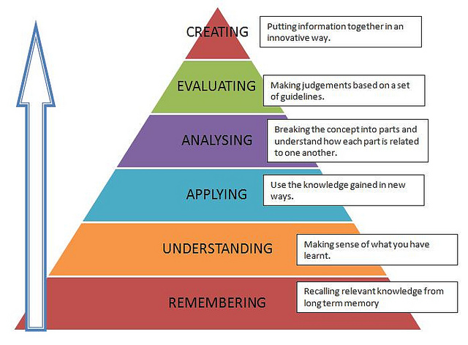
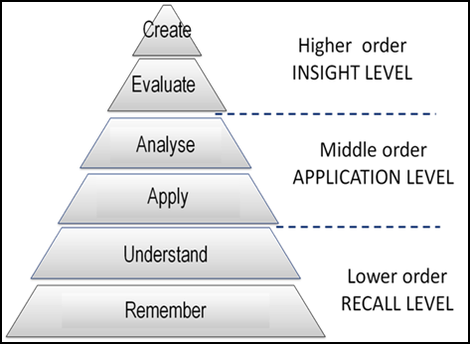
Taxonomies of Assessment

Slide 14
RECALL (Lower order) |  | APPLICATION (Middle order) |  | INSIGHT (Higher order)
Remember (Knowledge) | Understand (Comprehension) | Apply | Analyse | Evaluate | Create
define, describe, identify, label, list, match, name, outline, reproduce, select, show, state, arrange, collect, examine, tabulate, quote | convert, defend, explain, extend, generalise, give examples, infer, paraphrase, associate, rewrite, summarise, select, classify, discuss, review, report | compute, demonstrate, discover, manipulate, modify, operate, predict, prepare, produce, relate, show, solve, use, apply, calculate, illustrate, interpret, examine, classify, put into practice | break down, differentiate, discriminate, distinguish, illustrate, infer, outline, point out, relate, select, separate, subdivide, analyse, appraise, calculate, compare, criticise, derive, choose, examine, organise, deduce, divide | appraise, assess, defend, determine, evaluate, compare, conclude, contrast, criticise, discriminate, justify, interpret, relate, summarise, support, recommend, convince | compose, create, design, integrate, plan, originate, relate, invent, revise, synthesize, construct, develop, propose, modify

Slide 15
Cognitive levels | Diploma |  |  | Advanced Diploma Bachelor’s Degree | PGDip Bachelor Honors Professional Bachelors
NQF Level | 5 | 5,6 | 6 | 7 | 8
Low e.g. Recall | 60% | 30% | 20% | 10% | 5%
Medium e.g. Application | 30% | 60% | 50% | 40% | 35 %
High e.g. Evaluation | 10% | 10% | 30% | 50% | 60 %

Slide 16
Cognitive level analysis
Question | Recall | Application | Insight
 | Total marks: | Total marks: | Total marks:
1.
2.
3.
4.
5.
Total:
Percentage: | % | 0% | 0%

